Slide 1
3 point property maximize

Slide 2
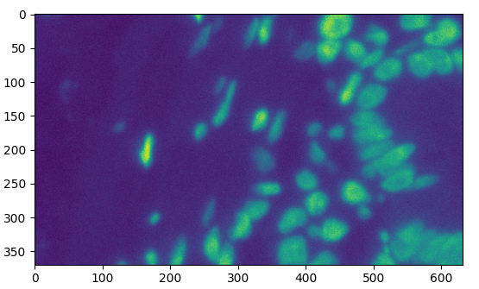
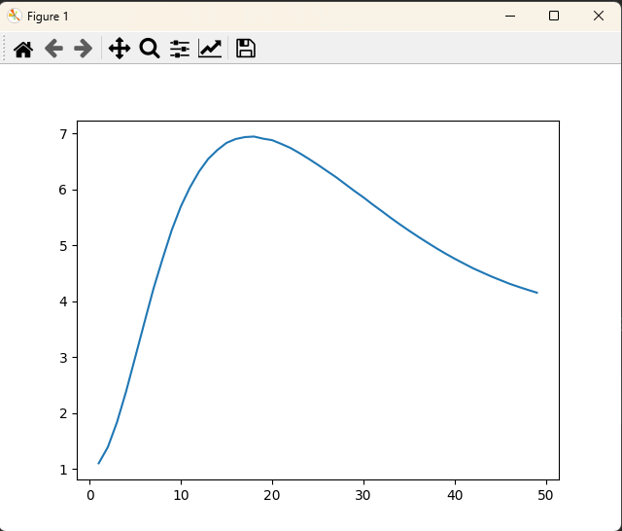
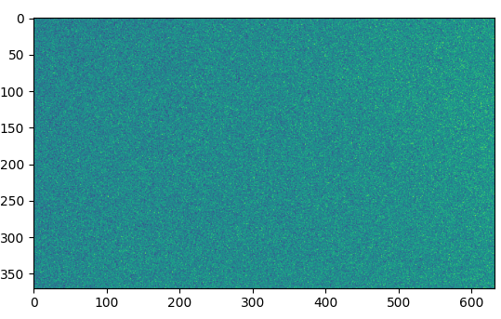
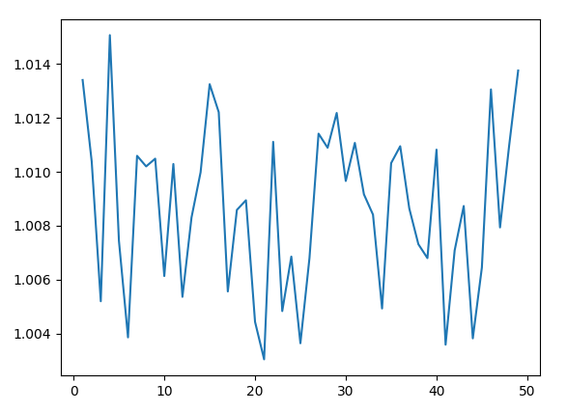
Skip range Size

Slide 3
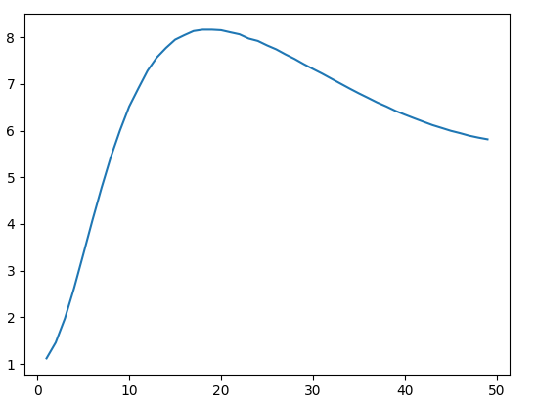
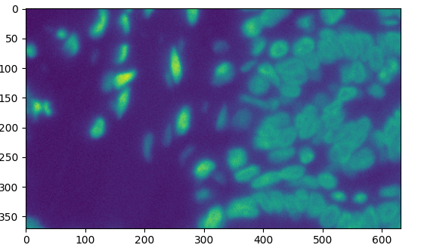
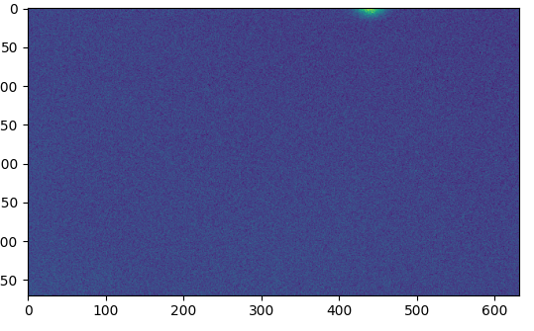

Slide 4
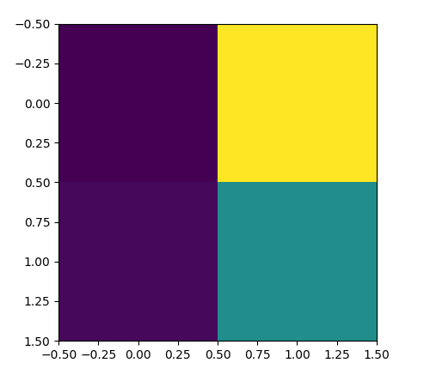
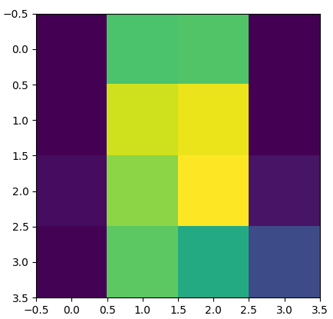
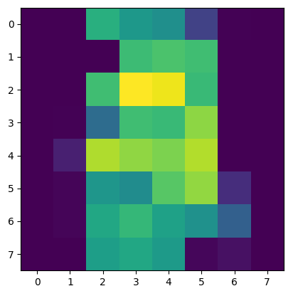
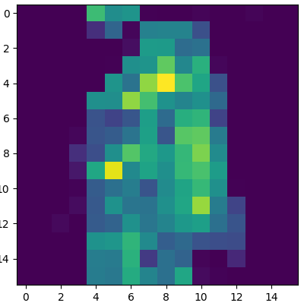

Slide 5
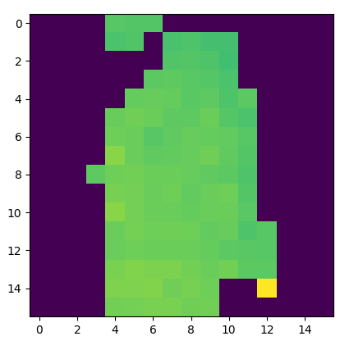

Slide 6
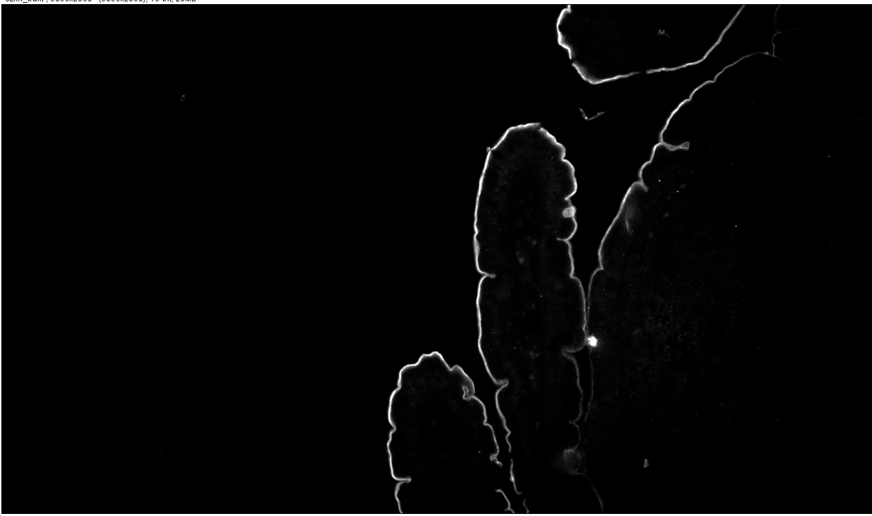
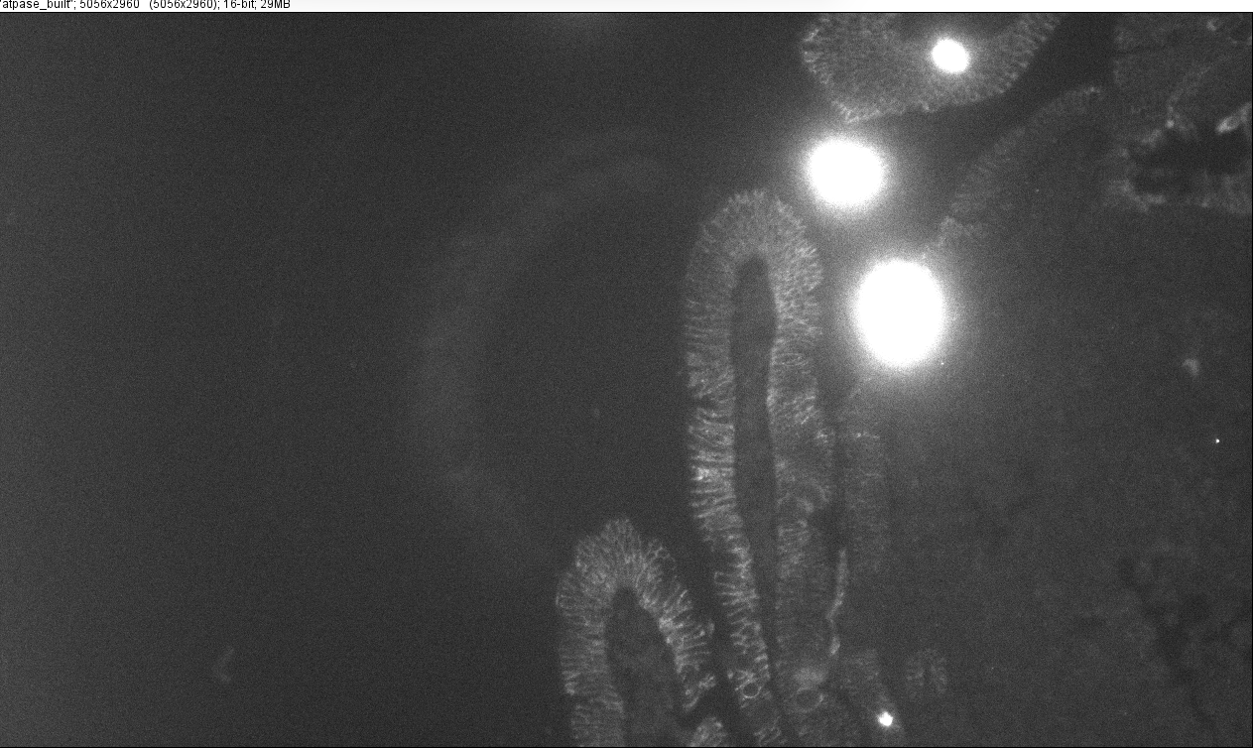

Slide 7
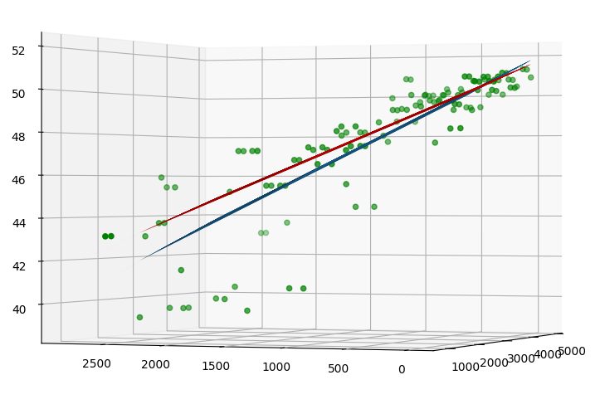
Huber
Linear Regression

Slide 8
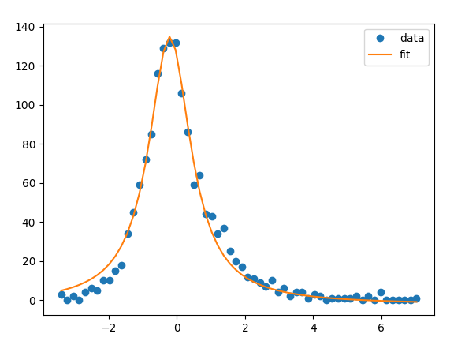
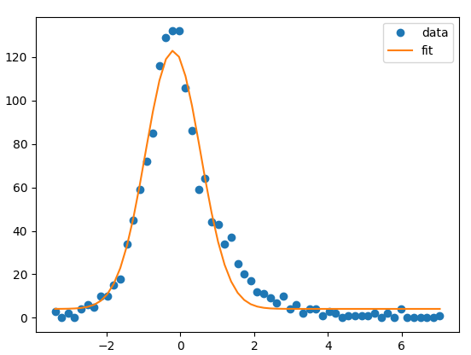
3 Point Brenner Noise Properties
We get error based on the 3 point brenner method.
How do the results distribute around the “known” answer?
To solve this, we generate the fitted plane and by eye we know this is a good fit to the data, although a few areas exist that don’t fit well (I suspect the slide moved in that area when capturing).
To find the distribution, we find the difference between the ‘known’ answer and the result in that spot. We then plot a histogram of points and fit with both a gaussian function and a Lorentzian function.
Lorentzian fits error distribution very well.
Offset = -0.2 um
Width = 1.5 um
Given depth of focus is around 2um, 1.5um for error is workable.
Lorentzian
Gaussian

